Slide 1

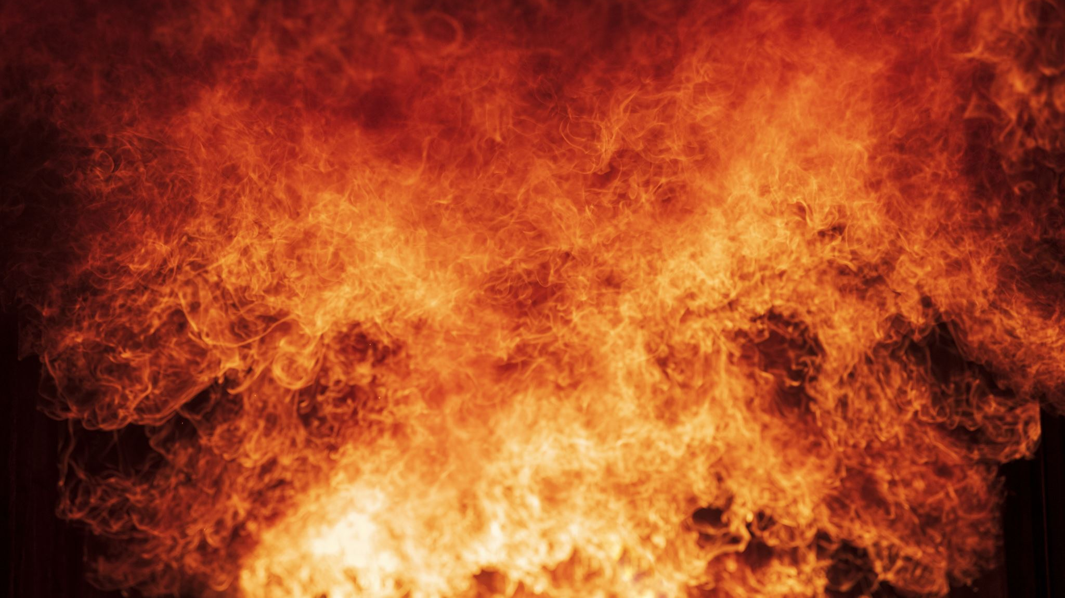
Oregon Fires
Jade Supino

Slide 2
Dataset obtained from oregon.gov Open Data Portal. Dataset name is ODF Fire Occurrence Data 2000-2022. https://data.oregon.gov/Natural-Resources/ODF-Fire-Occurrence-Data-2000-2022/fbwv-q84y Dataset contains 23.5k items and 38 attributes.
Objectives :
1. Fire information about each area of Oregon
2. Find the different types of fire causes
3. Categorize the fires by size
4. Find the top 20 largest fires in Oregon between the years 2000 and 2022
5. Find all Oregon fires that occurred in 2022
6. Oregon Fires by Fire Year, Category, and Size
Background
Fires are a natural occurrence throughout Oregon.
Oregon has a varied geography, many different forest types, wildlife, and plant species.
Forests in Oregon cover approximately 30.5 million acres, almost half the state (2).
ODF stands for the Oregon Department of Forestry. To improve the sustainability of the environment, economy, and community, the ODF is responsible for protecting and managing the forests of Oregon (3).

Slide 3
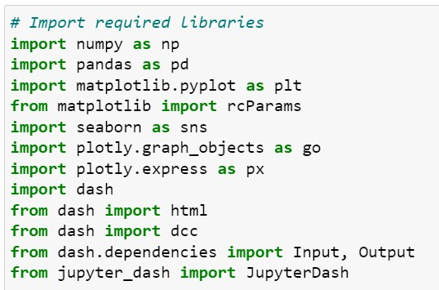
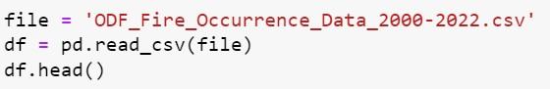
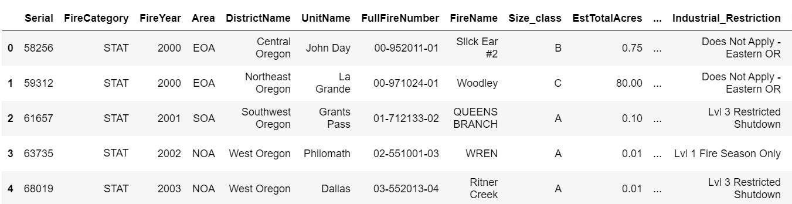
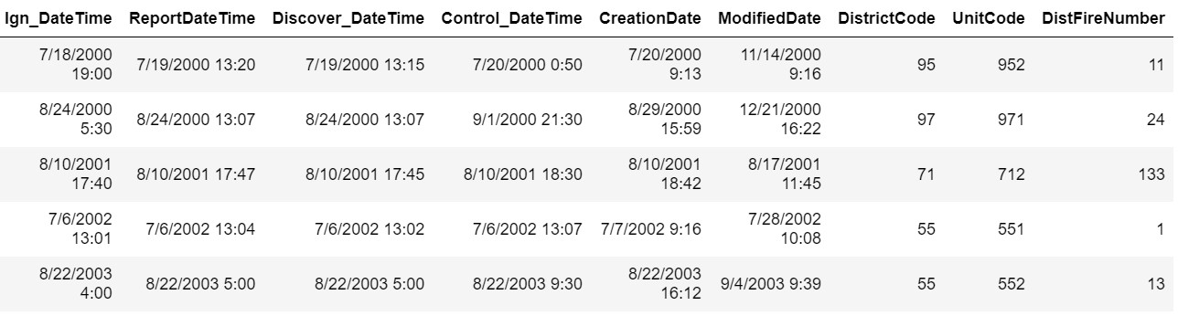
Data Loading
Load the csv file
Convert to a Pandas DataFrame

Slide 4
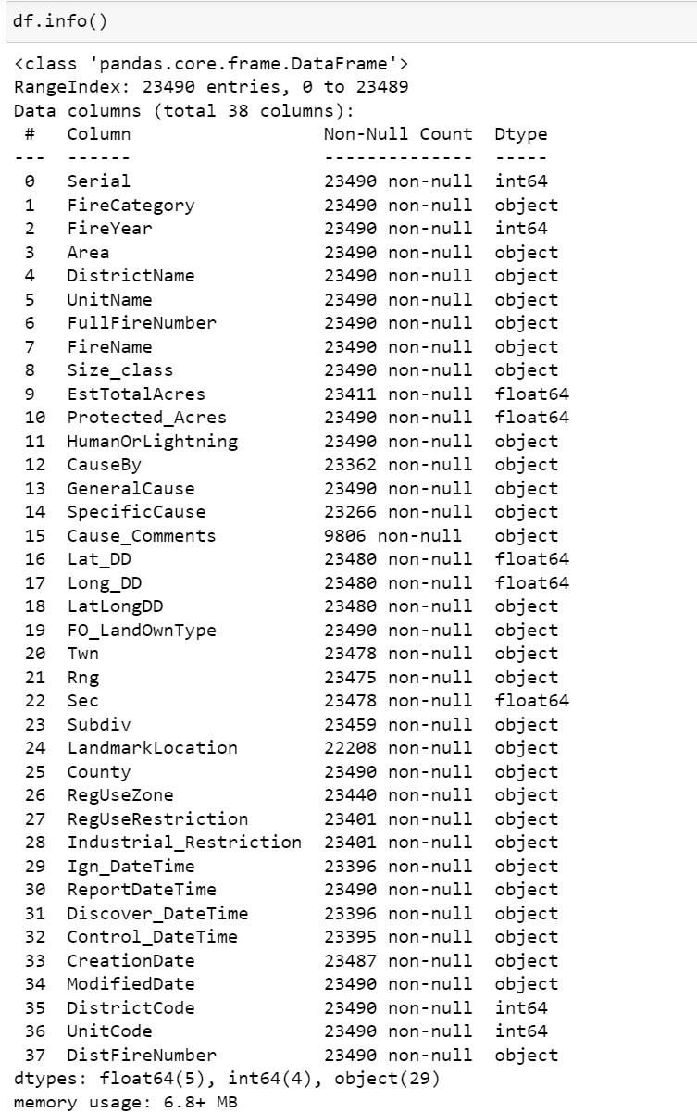
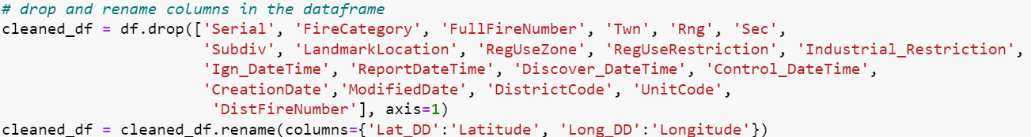
Data Cleaning
Drop the following attributes:
Serial
FireCategory
FullFireNumber
Twn
Rng
Sec
Subdiv
LandmarkLocation
RegUseZone
RegUseRestriction
Industrial_Restriction
Ign_DateTime
ReportDateTime
Discover_DateTime
Control_DateTime
CreationDate
ModifiedDate
DistrictCode
UnitCode
DistFireNumber
Rename columns Lat_DD to Latitude and Long_DD to Longitude.

Slide 5
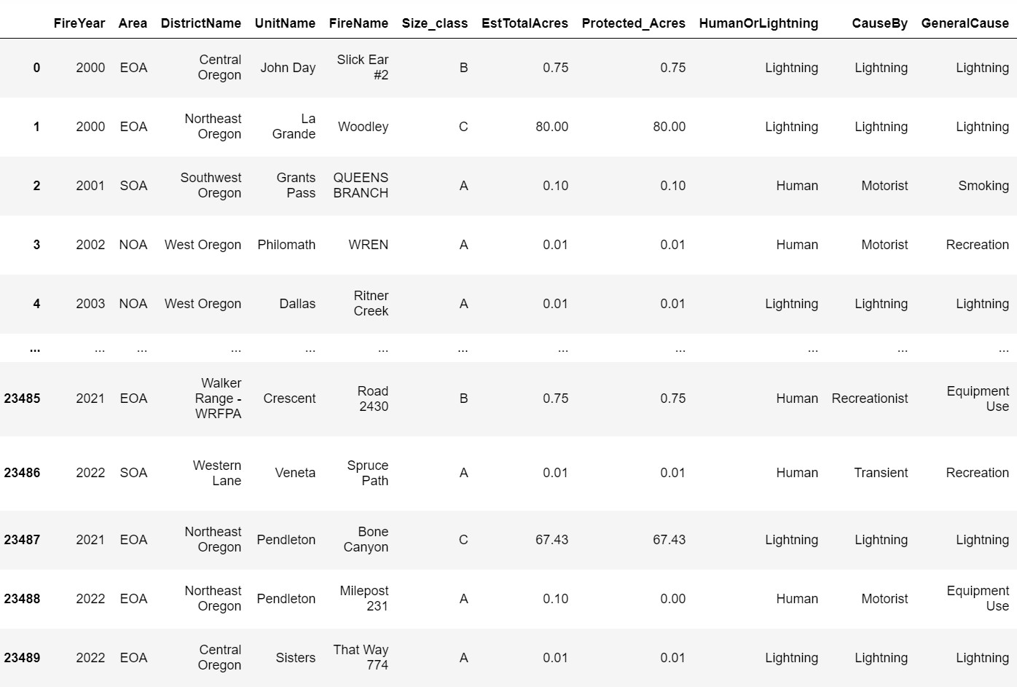
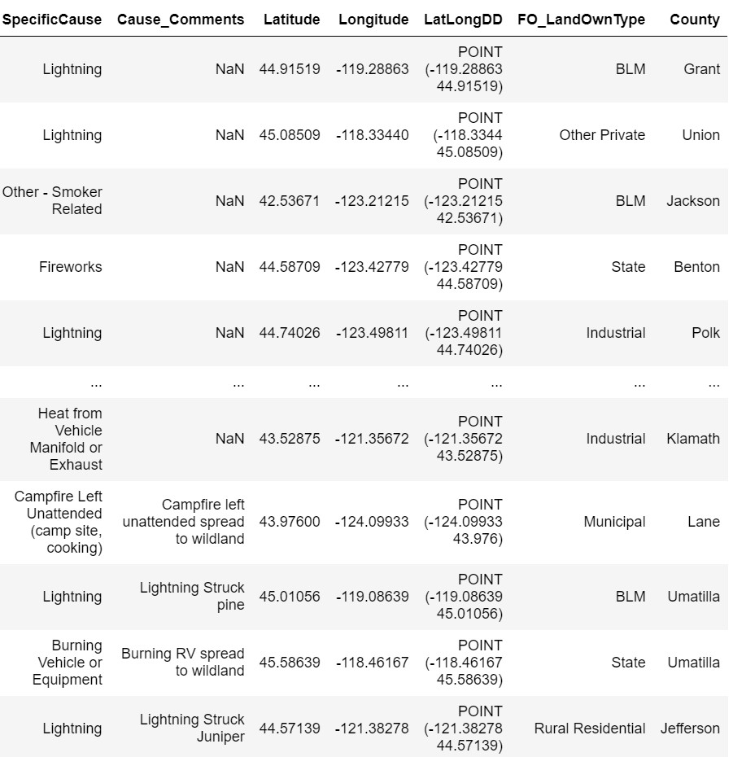
Data Cleaning
23490 rows × 18 columns

Slide 6
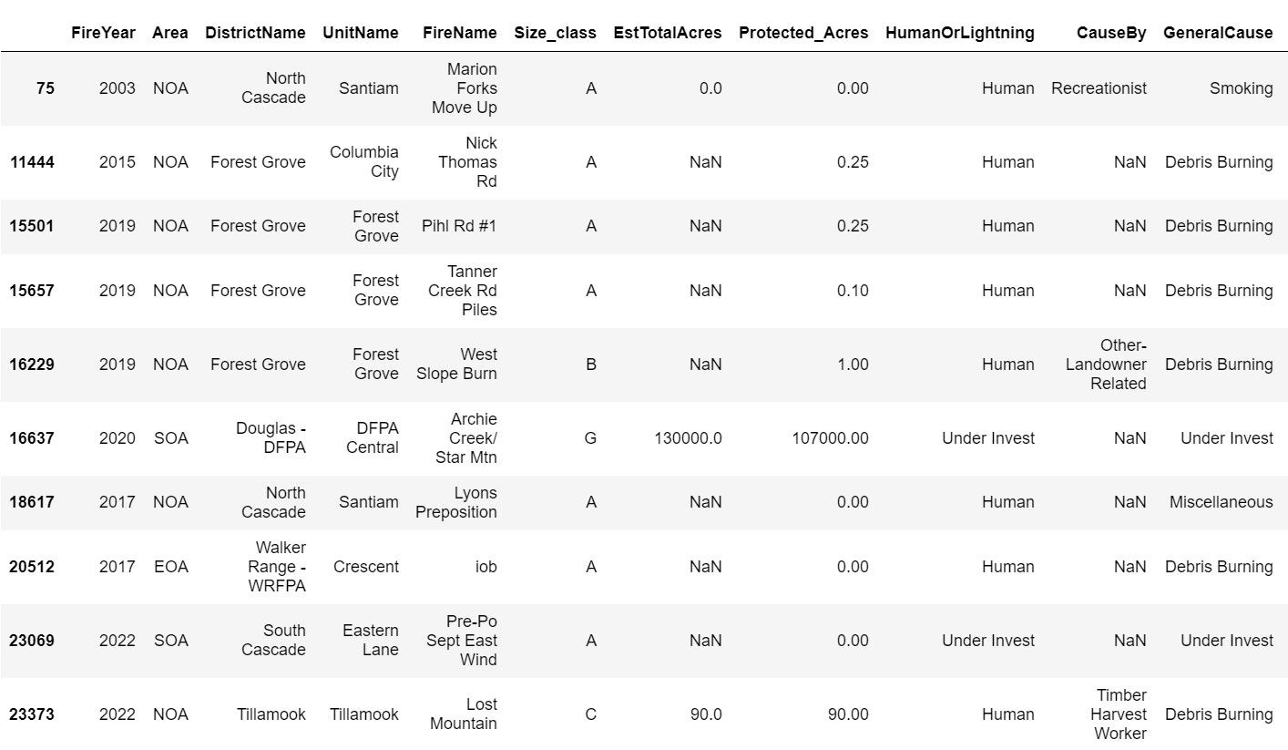
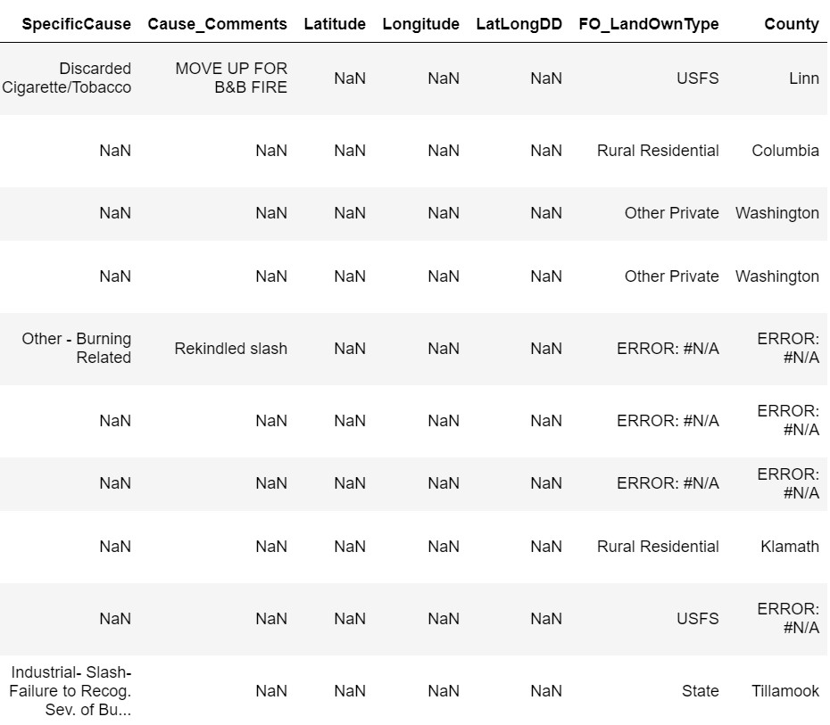
Data Cleaning
Check NaN values for Latitude
Drop 10 rows
23480 rows × 18 columns
Notes:
There are only 10 rows of NaN values. Since there are only a small amount of NaN values, it will not impact the analysis, so we will just drop them from the DataFrame. After dropping these values, there are now 23,480 rows.

Slide 7
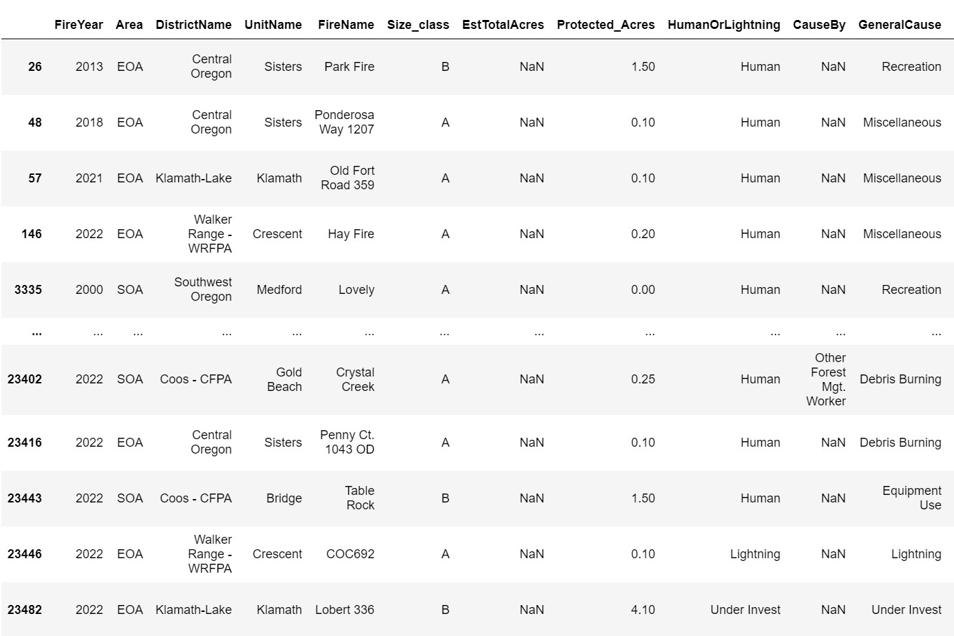
Data Cleaning
Check NaN values for EstTotalAcres
Group each fire into their size class
Fill NaN values with the mean of each class size

Slide 8

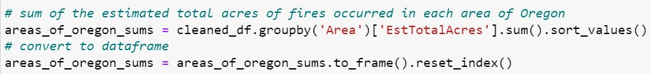
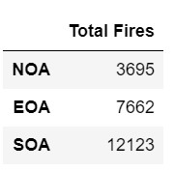
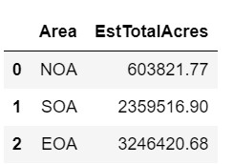
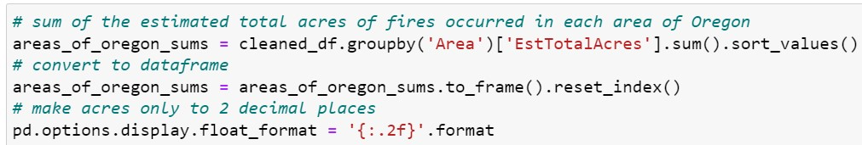
Information About Each Area Of Oregon
1. How many total fires occurred in each area?
2. What area has experienced the greatest number of fires?
3. What are the total estimated total acres burned in each area?
4. What area has had the greatest number of acres burned?
EOA: East
NOA: North
SOA: South

Slide 9
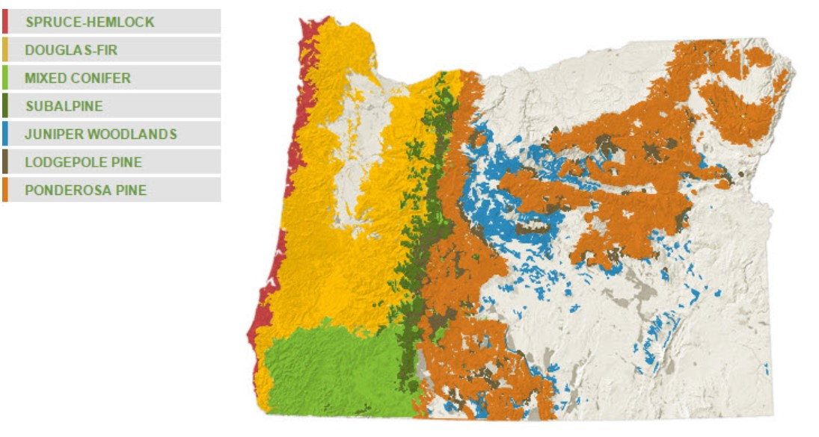
Information About Each Area Of Oregon
EOA: Eastern Oregon Area
NOA: Northern Oregon Area
SOA: Southern Oregon Area
About Oregon's forests. Oregon Department of Forestry : About Oregon's forests : Forest benefits : State of Oregon. (n.d.). Retrieved April 24, 2023, from https://www.oregon.gov/odf/forestbenefits/pages/aboutforests.aspx

Slide 10
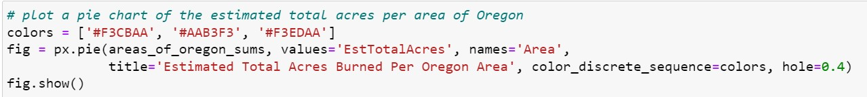
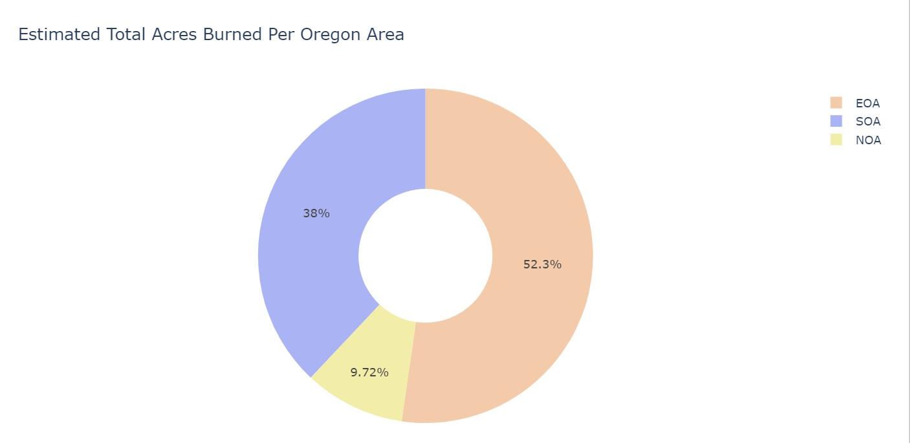
Information About Each Area Of Oregon
Figure 1. The pie chart represents the three areas of Oregon. Eastern Oregon area has experienced the greatest estimated total acres burned, with approximately 52.3%.

Slide 11
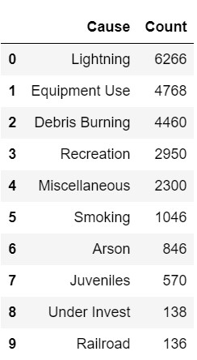
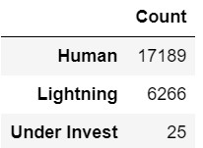
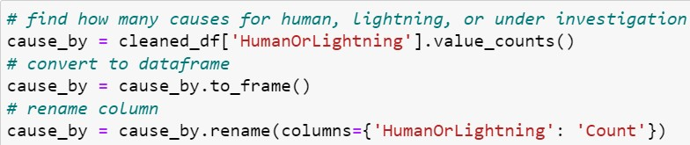
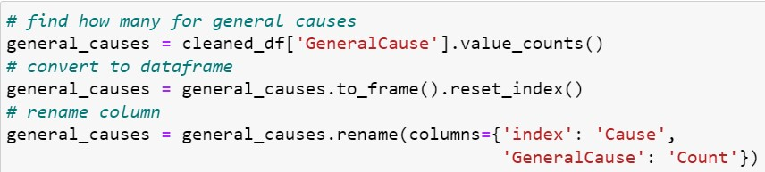
Types of Fire Causes
General causes
Categories
1. What are the types of categories for fire causes?
2. How many fires have occurred for each category from 2000 to 2022?
3. What are the general causes of Oregon fires and how many fires have occurred for each?

Slide 12
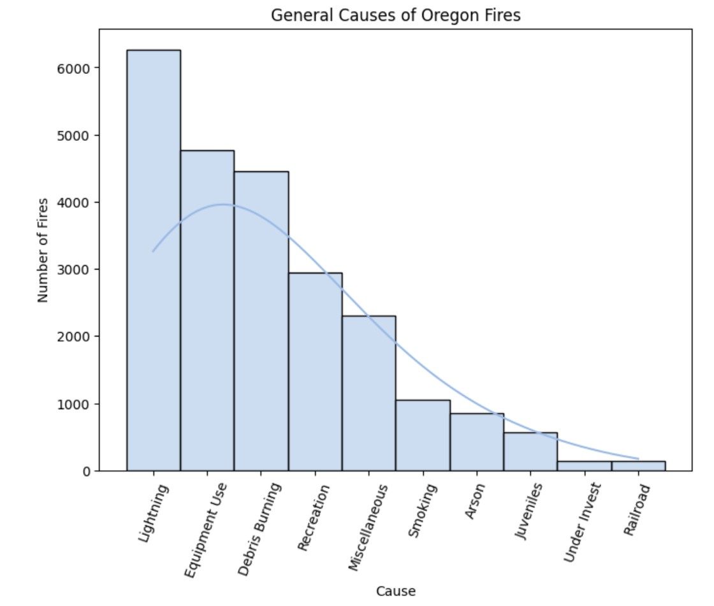
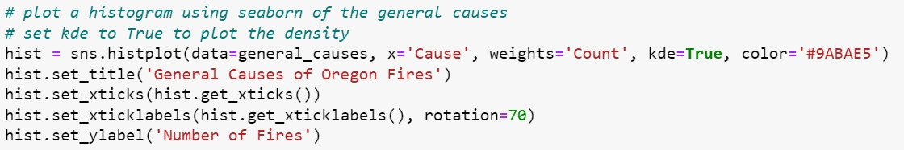
Types of Fire Causes
Figure 2. The general causes and the number of fires that have occurred are plotted in the histogram. The density curve shows the overall distribution shape. Out of the general causes, lightning has caused the most fires and railroad incidents have caused the least number of fires.

Slide 13

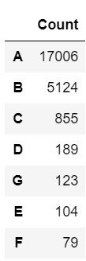
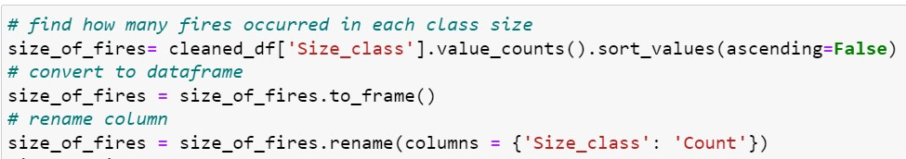
Fire Class Sizes
A
B
C
D
E
F
G
1. What class size of fire has occurred the most over the years?
2. What are the differences for class A and class G fires?

Slide 14
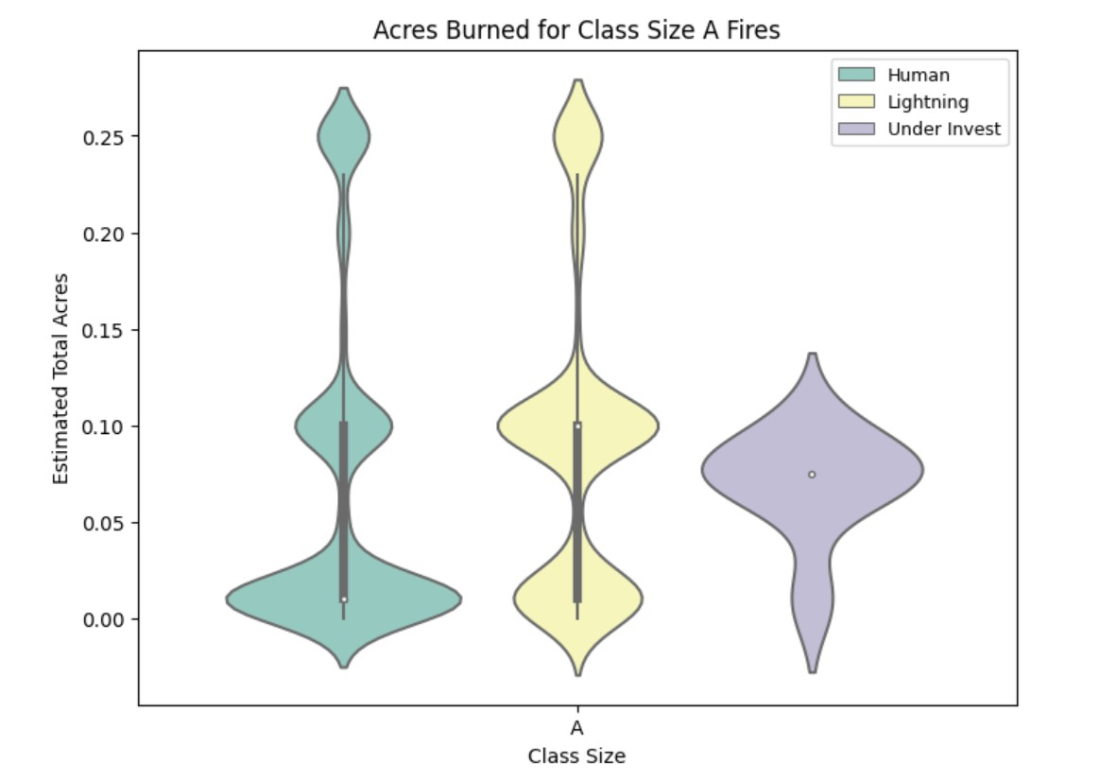
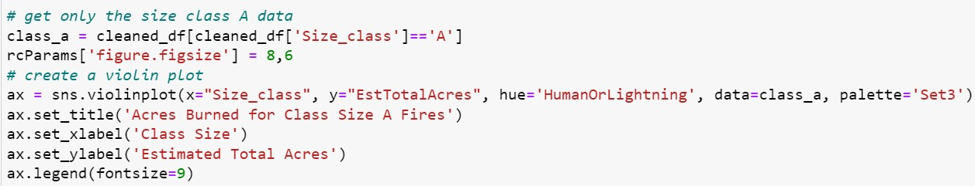
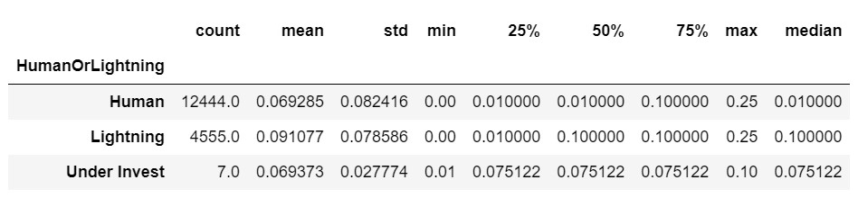
Class A Fires
Figure 3. The three violin plots represent the estimated total acres burned for class size A categorized by cause. The causes include human, lightning, or under investigation. The distributions for human and lightning causes are similar and both contain some outliers. Most of the fires under investigation are approximately similar in terms of acres burned.

Slide 15
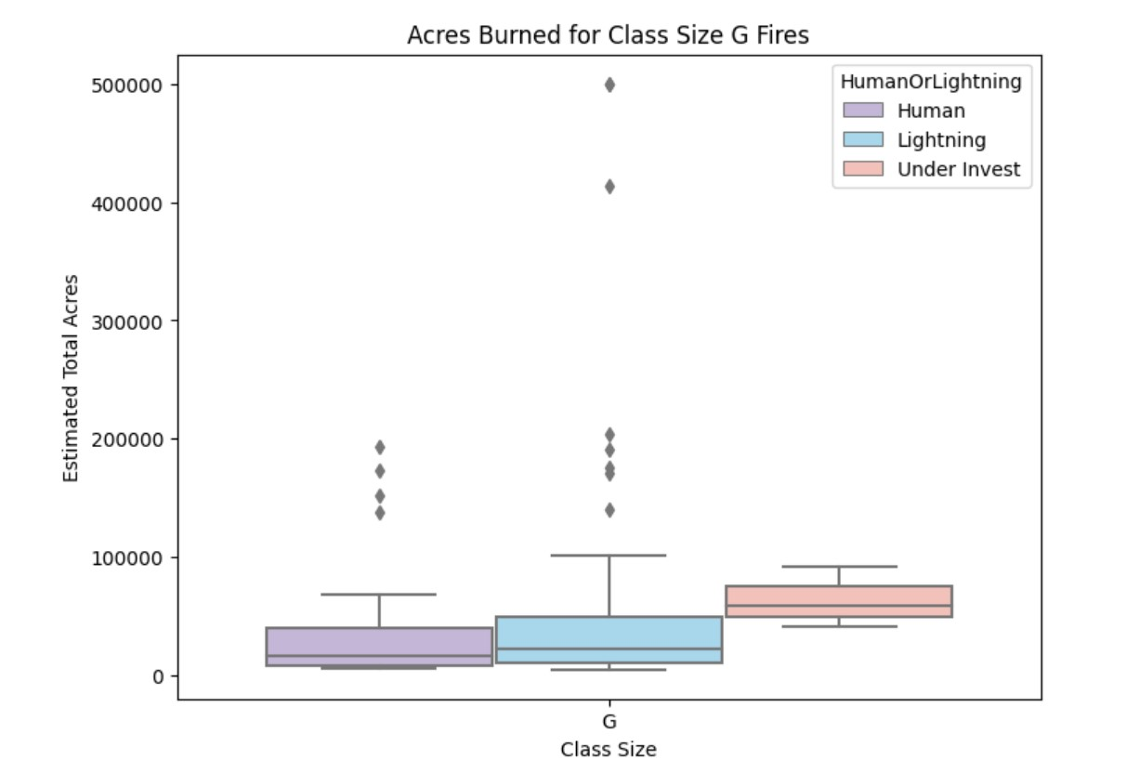
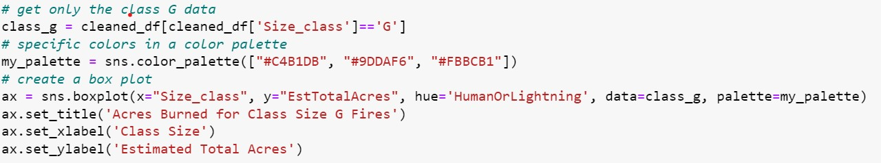
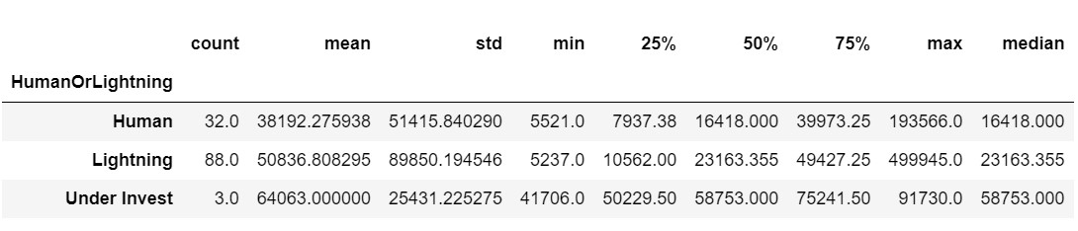
Class G Fires
Figure 4. Class G fires are plotted in the box plot, categorized by the type of fire cause: human, lightning, or under investigation. It is shown that the human and lightning plots have outliers, whereas under investigation plot does not. For the lightning category, the estimated total acres burned is very high and has very far outliers with the greatest number of acres burned.

Slide 16
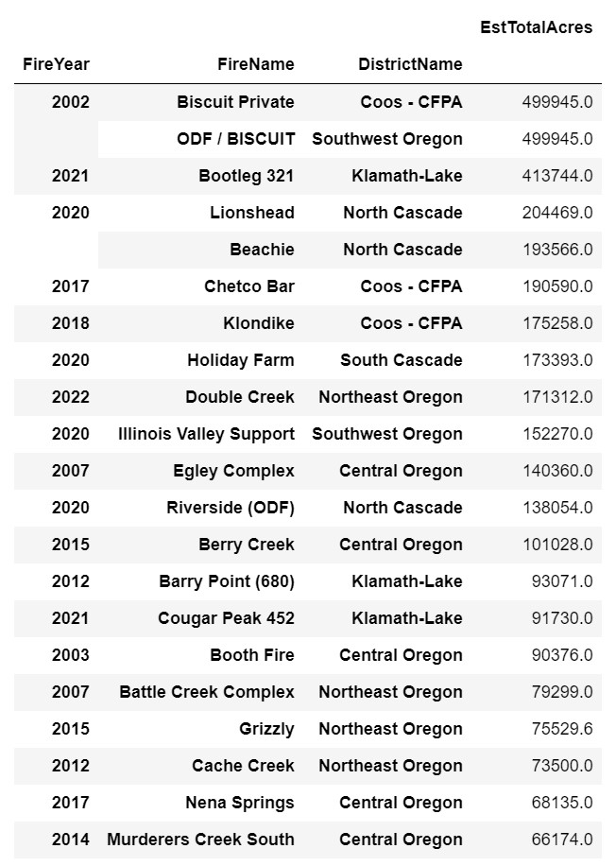
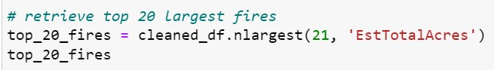
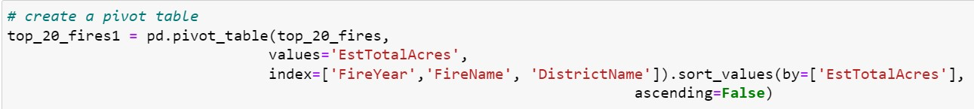
Top 20 Largest Fires
2000-2022
What was the largest fire over the years?
What was the fire name?
How many total acres was the fire?
What year was the fire and what was the general cause of the fire?
What year had the greatest number of largest fires?
Note: The top 21 fires were found because the first two are the same fire.

Slide 17
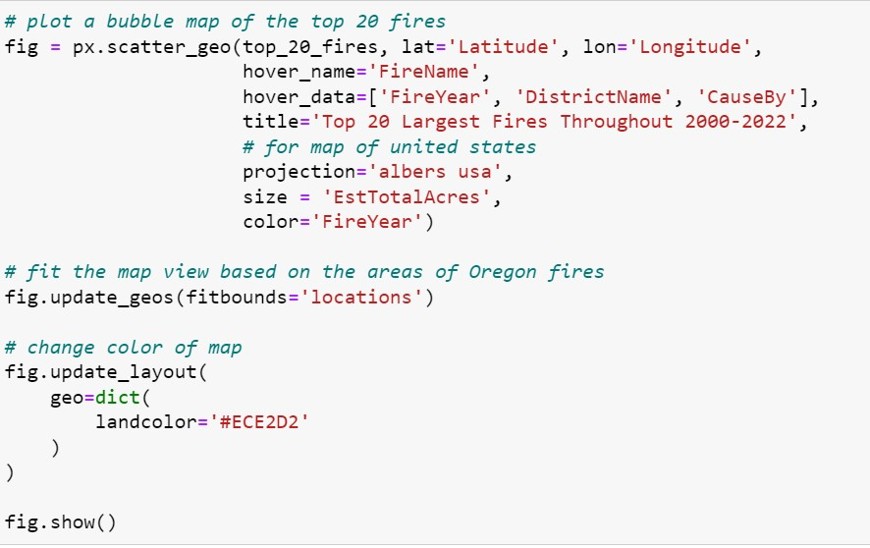
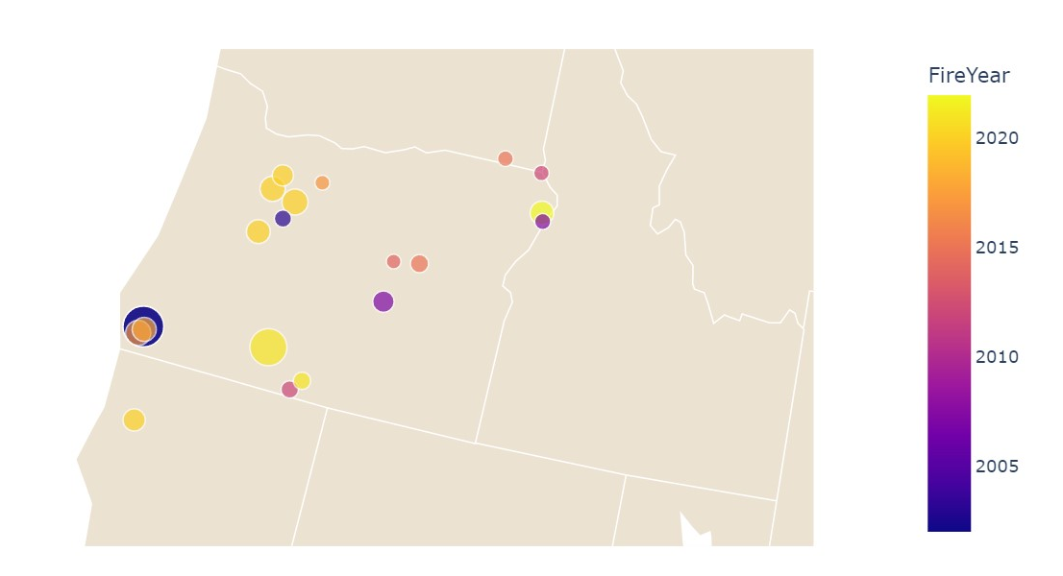
Top 20 Largest Fires 2000-2022
Biscuit Private
Figure 5. The bubble map represents the top twenty largest fires in Oregon. Each bubble represents a fire, where the fire name, estimated total acres, latitude, longitude, the year of occurrence, and the cause by is available. Fires outside of Oregon could be due to a spread of fire.

Slide 18
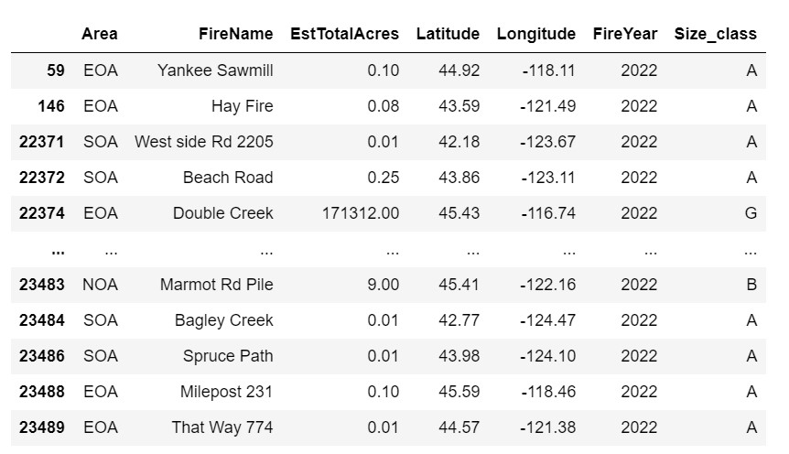
Oregon Fires
2022
What area of Oregon has had the greatest number of fires in 2022?
What area of Oregon has had the least number of fires in 2022?

Slide 19
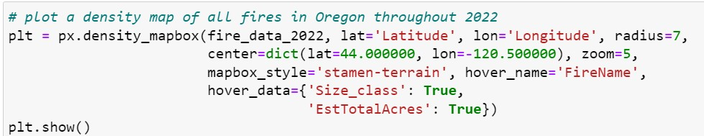
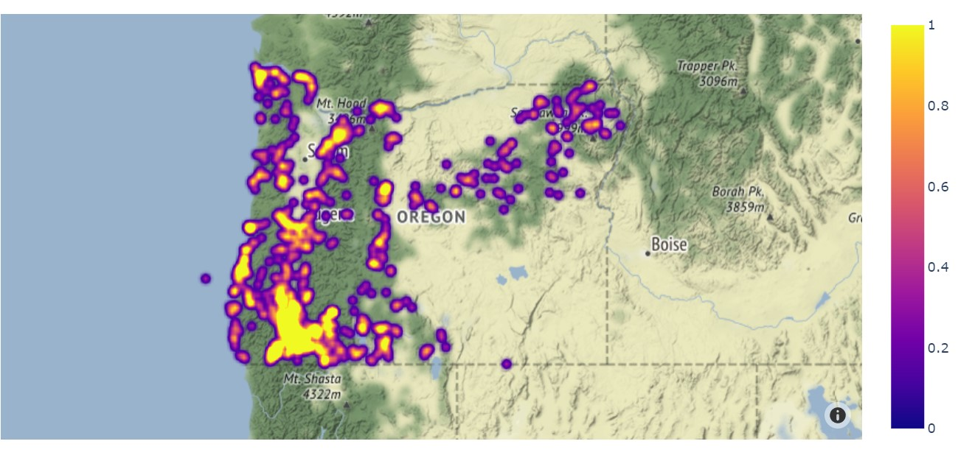
Oregon Fires 2022
Figure 6. A density map representing the fires in Oregon throughout 2022. The southwest region of Oregon has experienced the greatest number of fires, whereas the southeast has experienced the least.

Slide 20
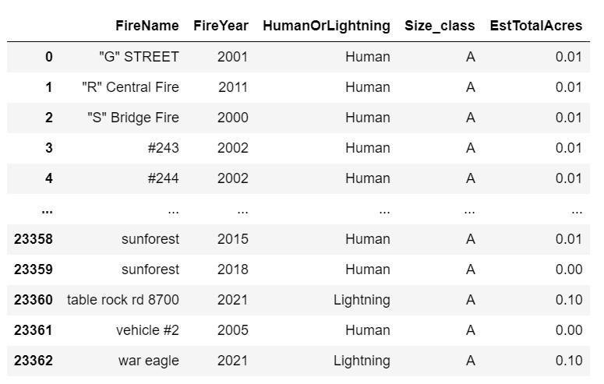

Oregon Fires by Fire Year, Category, and Size

Slide 21
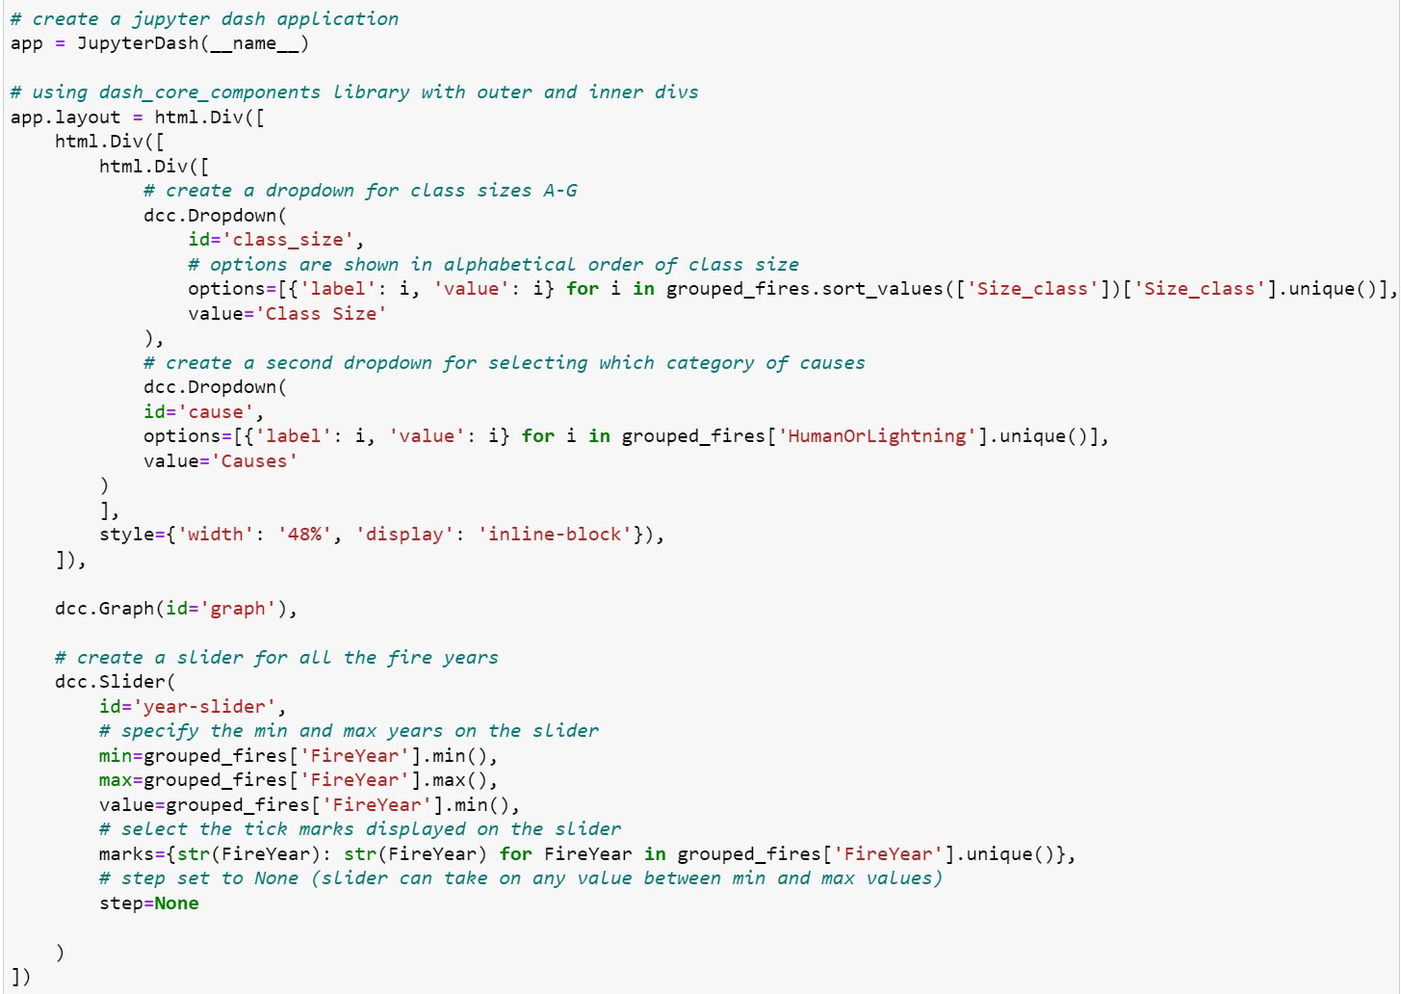
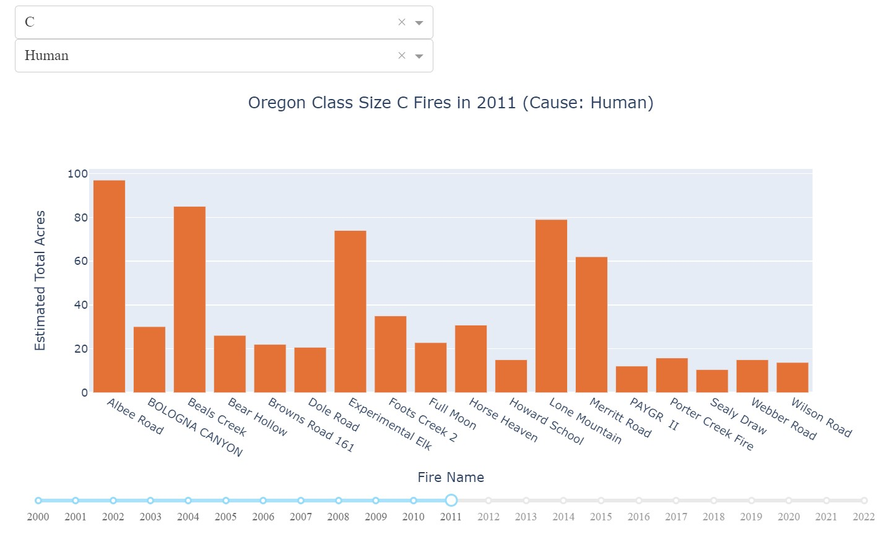
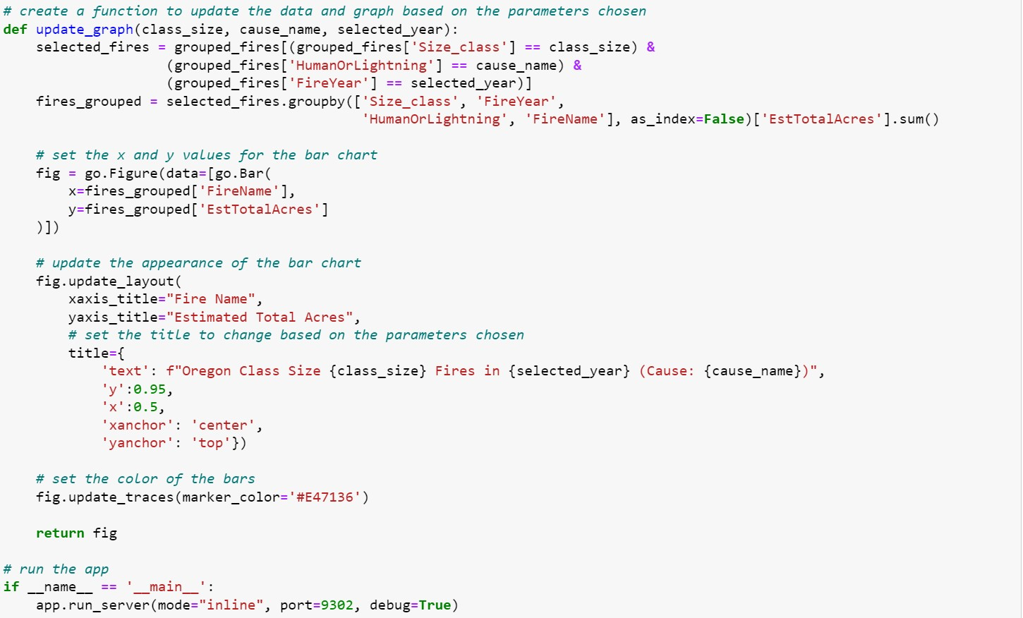
Oregon Fires by Fire Year, Category, and Size
Pick a class size
Pick a fire cause
Pick a year
Figure 7. A Jupyter dash application with two dropdown menus and a slider. The user selects a class size and category of cause (human, lightning or under investigation) and uses the slider to choose the specific fire year from 2000 to 2022. Based on the attributes selected, the corresponding fire names and their estimated total acres are plotted.

Slide 22
Summary
Areas of Oregon
Fire Causes
Fire Class Sizes
NOA: North
3,695 fires
603,821.77 acres burned
EOA: East
7,662 fires
3,246,420.68 acres burned
SOA: South
12,123 fires
2,359,516.90 acres burned
Human
Caused 17,189 fires
Lightning
Caused 6,266 fires
Under Investigation
25 fires
Class A
17,006 fires
Max acres burned: 0.25
Class B
5,124 fires
Class C
855 fires
Class D
189 fires
Class E
104 fires
Class F
79 fires
Class G
123 fires
Max acres burned: 499,945
Largest Fire
Fire Name (District):
Biscuit Private (Coos)
ODF / BISCUIT (Southwest Oregon)
Fire Year: 2002
Total Acres: 499,945
Class G Fire

Slide 23
References
ODF, TzA @. “ODF Fire Occurrence Data 2000-2022.” Oregon.gov, 19 Jan. 2023, https://data.oregon.gov/Natural-Resources/ODF-Fire-Occurrence-Data-2000-2022/fbwv-q84y.
About Oregon's forests. Oregon Department of Forestry : About Oregon's forests : Forest benefits : State of Oregon. (n.d.). Retrieved April 24, 2023, from https://www.oregon.gov/odf/forestbenefits/pages/aboutforests.aspx
About Us. Oregon Department of Forestry : About us : About ODF : State of Oregon. (n.d.). Retrieved April 25, 2023, from https://www.oregon.gov/odf/aboutodf/pages/default.aspx

Slide 24
Questions?

